Slide 1







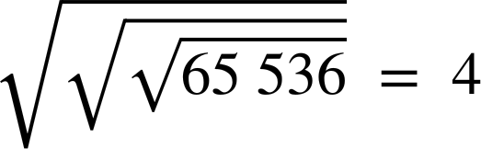




Powers and roots using a calculator
Task A: Evaluate a number using a square root
1) Evaluate the following. If your answer is a decimal, write all the digits from your calculator display.
a) Evaluate
11.9025
b) Evaluate
181
c) Evaluate
3.47
d) Evaluate
15
2) Using a calculator, work out the missing lengths of the following shaded areas. Each shape is a square.
Area = 127.69 cm²
Area = 0.00 000 1 m²
Area = 4.6225 m²
Length =
Length =
Length =
Length = 11.3 cm
Length = 2.15 m
Length = 0.001 m
3) Using a calculator, explain why the following evaluate to the answer given.
a)
b)
This means the square root of the square root of the square root of 65 536.
Square and square root are inverses, thus they cancel each other out.

Slide 2





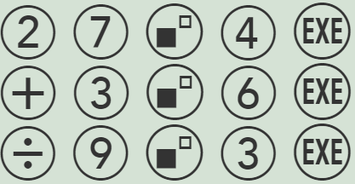




Powers and roots using a calculator
Task B: Evaluate using exponents
1) Evaluate the following. If your answer is a decimal, write all the digits from your calculator display.
a) Evaluate
2800
b) Evaluate
3
c) Evaluate
4.6305
d) Evaluate
13
2) Sofia followed this function machine. Her input was 27. Her output was 730.
To the power of 4
Add 3⁶
Divide by 9³
Which of the following buttons did she press to get the correct answer?
a
b
Mathematics in Education and Industry
v2.2

Slide 3

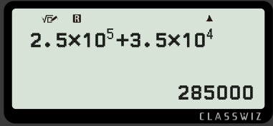
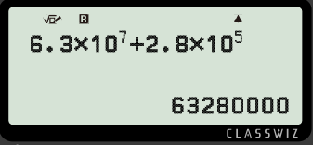
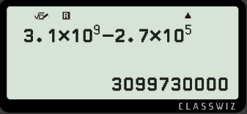
Powers and roots using a calculator
Task C: × 10^{x} button on a calculator
1) Evaluate the following:
a)
b)
c)
17 000
364 000 000
13 320
2) Work out the missing exponents.
a)
b)
c)
Mathematics in Education and Industry
‹#›

